Slide 1
Chapter 10: Testing Proportions
Textbook: Ahmad Daryanto, Introduction to Quantitative Research Methods for Marketing With SPSS and R: Tools and Techniques, Routledge. 2024

Slide 2
Learning Objectives
Know how to conduct a sample proportion test in SPSS and R.
Know how to conduct a statistical test the difference in two proportions using D2prop macro in SPSS and R.

Slide 3
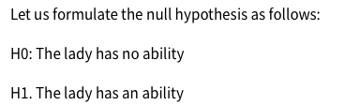
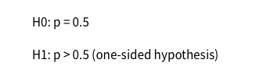
Testing A Single Proportion
Testing a statement or proposition about a single proportion
If the lady made a random guess:
If the null hypothesis is true, how likely was she to be correct 24 out of 30 times? Can we calculate the probability of making 24 correct guesses from 30 trials, which we calls p-value?

Slide 4
SPSS Action: A Chi-square test
Data. MagicLady.sav
Steps:
Analyze → Nonparametric Tests→Legacy Dialogs→Chi-Square.
After the SPSS windows appear on your screen, move the variable Guess into the Test Variable List box.
Next, click OK or Paste if you want to work with an SPSS syntax .
SPSS syntax:
NPAR TESTS
/CHISQUARE=Guess
/EXPECTED=EQUAL
/MISSING ANALYSIS.

Slide 5
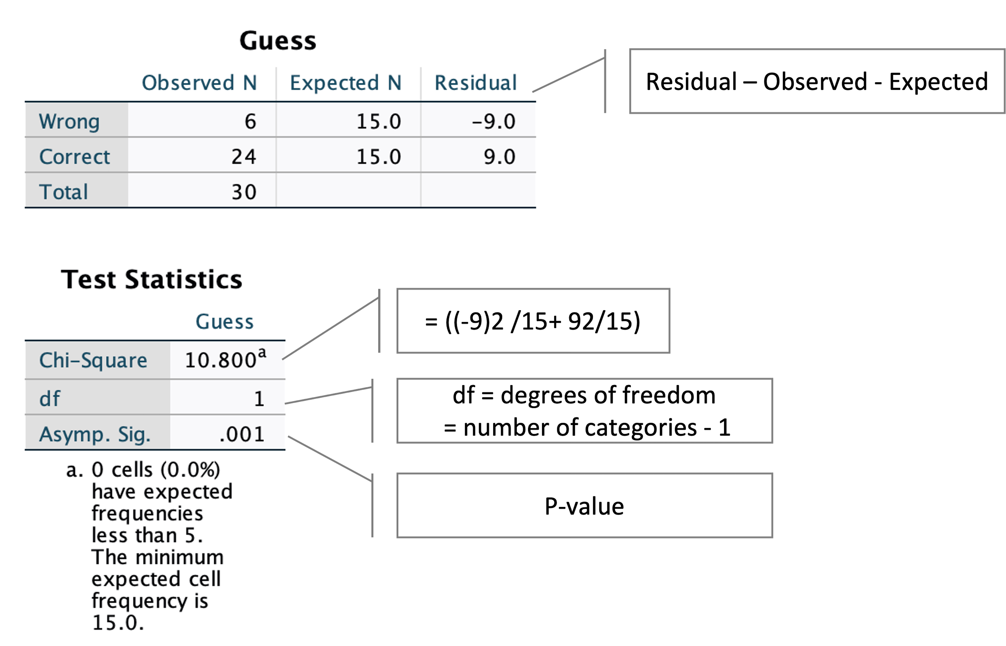

Slide 6
R Action: A Chi-Square Test
library(haven)
# Read data
dat <- read_spss("/Users/ahmaddaryanto/OneDrive - Lancaster University/dataspss/MagicLady.sav")
nsuccess <- sum(dat)
ncups <- nrow(dat)
nfails <- ncups - nsuccess
dat <- c(nsuccess, nfails)
res <- chisq.test(dat, p = c(0.5, 0.5))
res

Slide 7
SPSS Action: A Binomial test
Data. MagicLady.sav
Steps:
Analyze → Nonparametric Tests→Legacy Dialogs→Chi-Square.
After the SPSS windows appear on your screen, move the variable Guess into the Test Variable List box.
Next, click OK or Paste if you want to work with an SPSS syntax .
SPSS syntax:
NPAR TESTS
/CHISQUARE=Guess
/EXPECTED=EQUAL
/MISSING ANALYSIS.

Slide 8
R Action: A Binomial Test
library(haven)
# Read data
dat <- read_spss("/Users/ahmaddaryanto/Documents/Data1/MagicLady.sav")
nsuccess <- sum(dat)
ncups <- nrow(dat)
res <- prop.test(nsuccess, ncups, 0.5)
res

Slide 9
Assumptions of the Binomial test
The minimum expected value in a cell is at least 5.
The minimum sample size is 30 (see ?sec-CLT) for the test to provide a reliable result

Slide 10
Testing the Difference between Two Proportions
Imagine you are developing two types of video ads (say, ad A and ad B) to promote green behaviours. Because of your budget constraint, only one ad will be in the actual production. You decide to run an experiment by randomly assign customers to watch either ad A or ad B for few minutes. After they finished watching the video clips, you asked them to engage in a task unrelated to the ads. Next, you asked the consumers whether they could recall the name of your new brand.

Slide 11
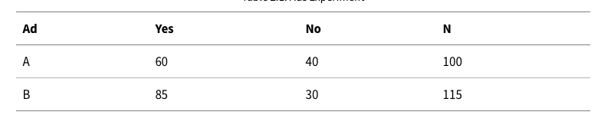
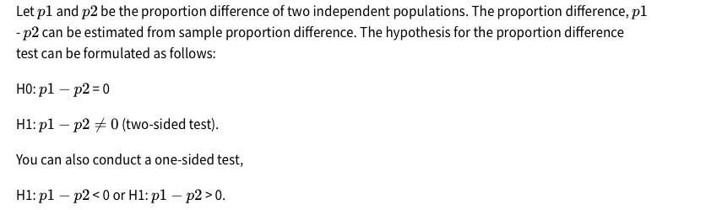

Slide 12
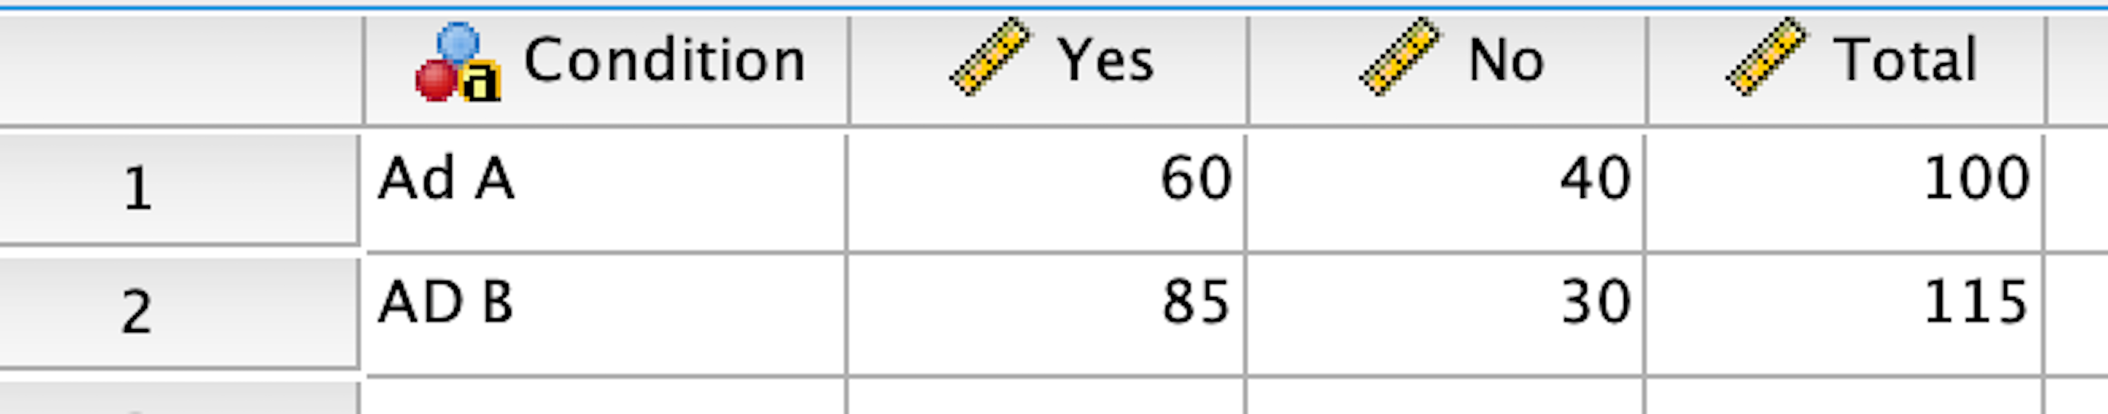
SPSS Action: D2prop Macro
You can download the macro from this website https://www.tqmp.org/RegularArticles/vol18-2/p181/
D2prop macro requires a special format for its input.

Slide 13
SPSS Action: D2prop Macro
Follow these steps:
Analyze→D2prop by Ahmad Daryanto.
Insert variable Yes into the Success box. Yes is a variable that contains the frequency of success. In this box, you can enter multiple variables at once and the macro will calculate the proportion of success for each of them.
Insert variable Total into the Total box.
In the Confidence Level (%) box, set a confidence level you want to, say 95 for the 95% confidence level. This confidence level will be printed out at the end of the macro’s outputs.
Click OK. Do not click Paste – if you do so, you will see a long list of codes in a syntax file.

Slide 14
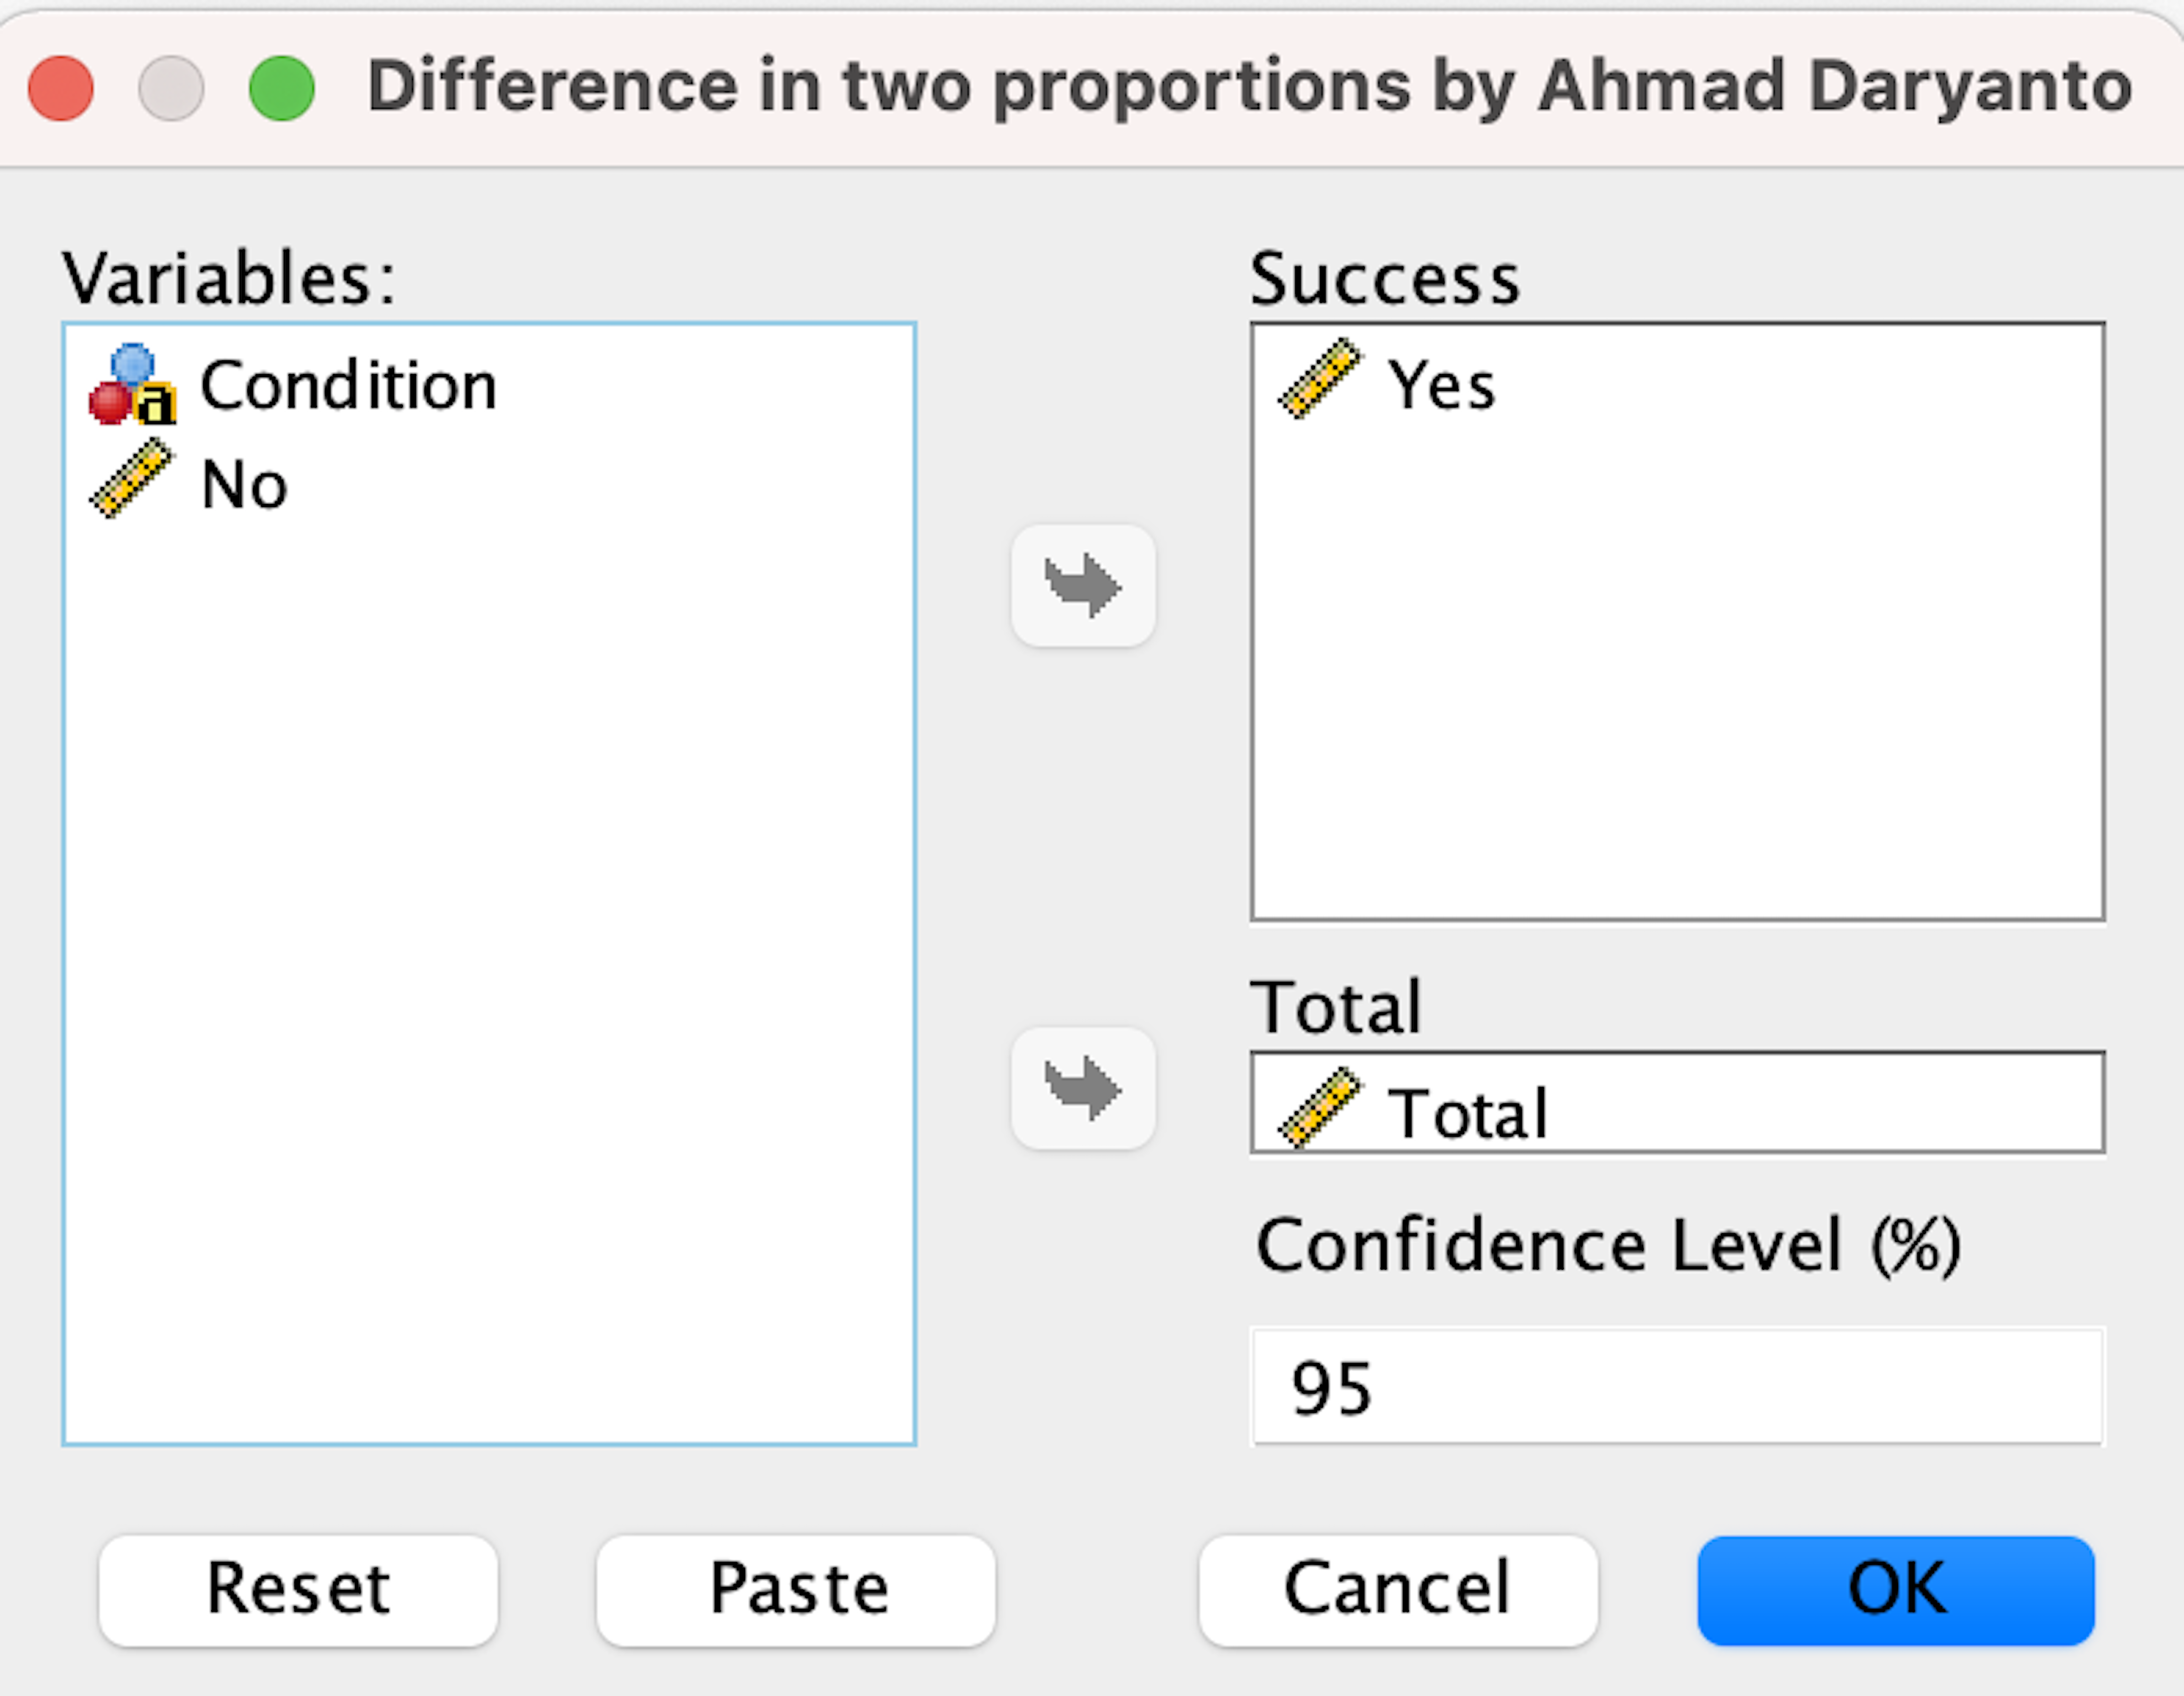
SPSS Action: D2prop Macro

Slide 15
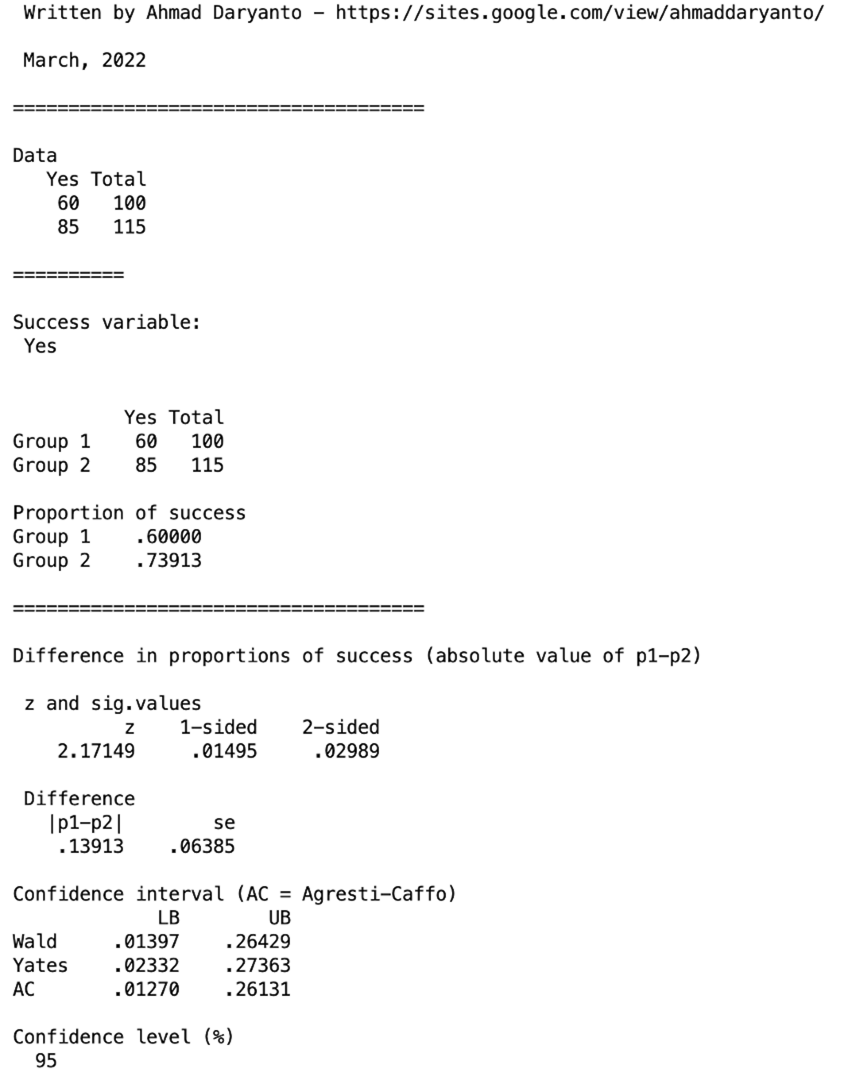
Proportion difference (13.9%) is significant (two-sided p-value = 0.03 < 5%). 95% CI : (0.013, 0.261).

Slide 16
R Action: Testing The Difference in Two Proportions
library(haven)
# Read data
dat <- read_spss("/Users/ahmaddaryanto/Documents/Data1/Ads.sav")
library(DescTools)
## Call the function
dprop <- BinomDiffCI(85, 115, 60, 100, conf.level = 0.95, method = "ac")
res<-round(dprop, 3) # the result is rounded to 3 decimal places.
res

Slide 17
Crosstabs

Slide 18
SPSS Action

Slide 20
Since p-value < 5%, we reject H₀ at the 5% level.
Make sure no cells having expected count is less than 5!
See next slide
At 1% significance level, the null hypothesis of no association between gender and product type is rejected. When shopping, female customers appear to be more inclined to buy utilitarian products than male.

Slide 21
This value tells us something about
the strength of association
Guidelines (Cohen 1988):
The phi coefficient ranges from 0 to 1
0.1 → small
0.3 → medium
0.5 → large
If the contingency table is larger than 2x2, use Cramer’s V to express the strength of association.
n = number of observation
L = the smaller of the number of categories
of the two variables.

Slide 22
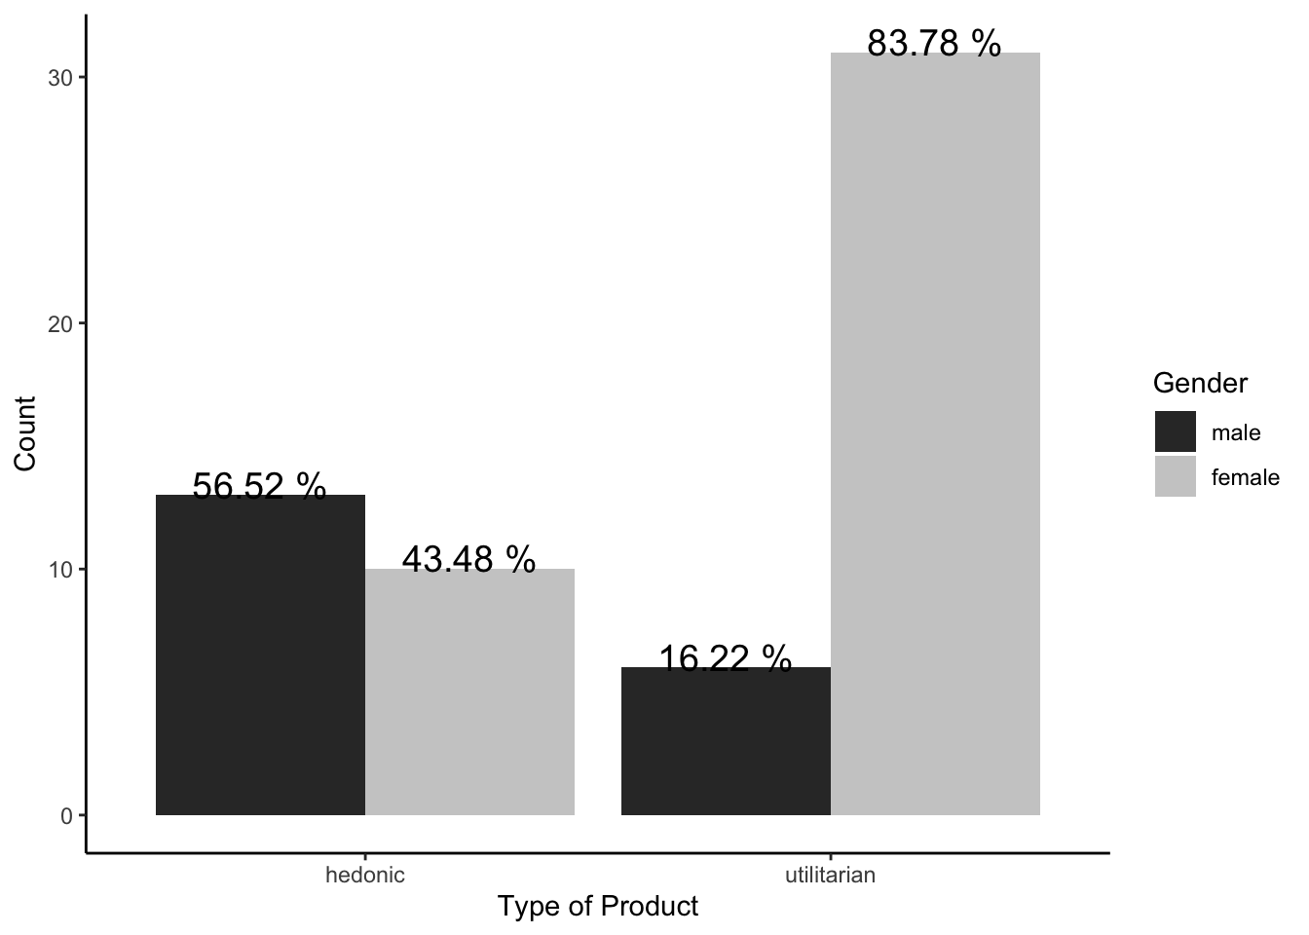
R Action
#
library(haven)
library(tidyverse)
# Read data
dat <- read_spss("/Users/ahmaddaryanto/Documents/Data1/store satisfaction.sav")
# Proportion chart, where bars sum to 100% within Recycle
table_dat <- dat %>%

Slide 23
R Action
table_dat %>%
ggplot(aes(x = prod, y = count, fill = gender)) +
geom_bar(position = 'dodge', stat = 'identity') +
scale_fill_grey() +
labs(y = "Count",
x = "Type of Product",
fill = "Gender") +
geom_text(aes(label = paste(percent,"%")),
colour = "black", size = 5,
vjust = 0.1, position = position_dodge(0.9)) +
theme_classic()
table_dat
# Specify as factors
mutate(prod = as_factor(prod)) %>%
mutate(gender = as_factor(gender)) %>%
# Compute frequency within each combination
group_by(prod, gender) %>%
summarize(count = n()) %>%
# Compute proportions within prod
# n is the default variable created by count()
group_by(prod) %>%
mutate(percent = round(count/sum(count)*100))

